Slide 1
Week 1 - CYBS 3743: Cyberforensics Fundamental
January 21st 2025
Sungbo Jung

Slide 2

Learner’s Ethics
Do the Right Thing!
Images from https://boardagenda.com/

Slide 3
I/O controller
Northbridge
High-speed (Memory and PCI-E)
Southbridge
Low-speed (IDE, SATA, PCI, and USB)

Slide 4
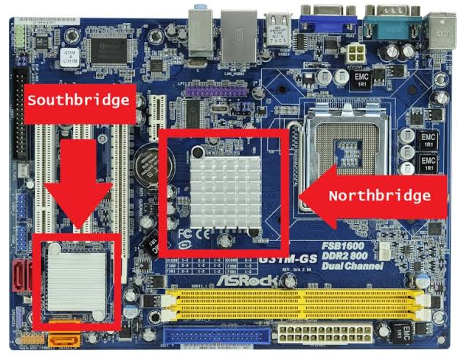
Motherboard
Images from https://www.wepc.com/

Slide 5
Chip Integration
Lower nm lithography
Pack more ICs
CPU can integrate the Northbridge
Images from https://semiengineering.com/

Slide 6

Digital data
Images from https://www.computersciencedegreehub.com/

Slide 7
Digital Data Characteristics
Invisible
Volatile
Easy to copy
Easy to modify
Large size
Remotely accessible

Slide 8
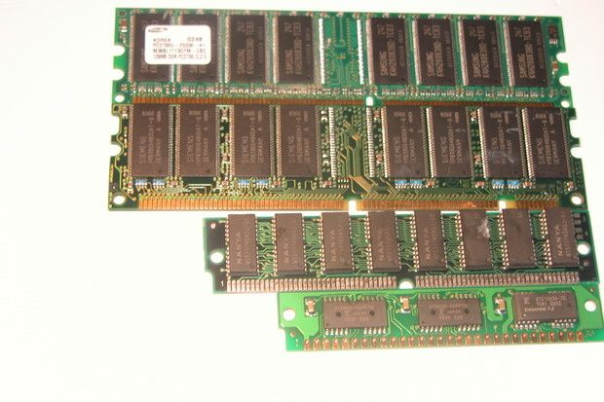
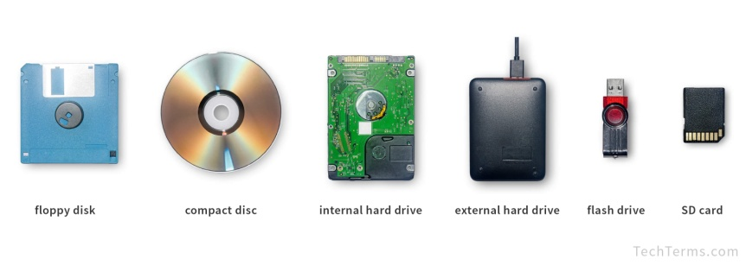
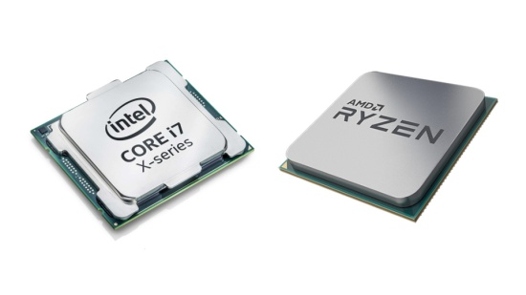
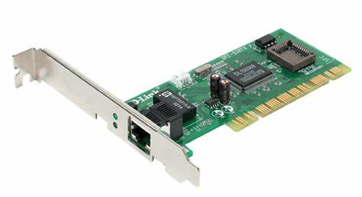
Computer Components
S/W
Data
Socket
User
Application
File
Kernel (O/S)
H/W
RAM
Volatile Memory
Disk Drives
Non-Volatile Memory
CPU
NIC

Slide 9
Data
in Memory
Faster speed and volatile
in DISK
So-so speed and persistence
over Network
Slower and illusion

Slide 10


